Slide 1

CO2 VEHICLE EMISSIONS ANALYSIS
"Reduce emissions, drive green"
Car Emissions
PowerPoint Presentation Template

Slide 2
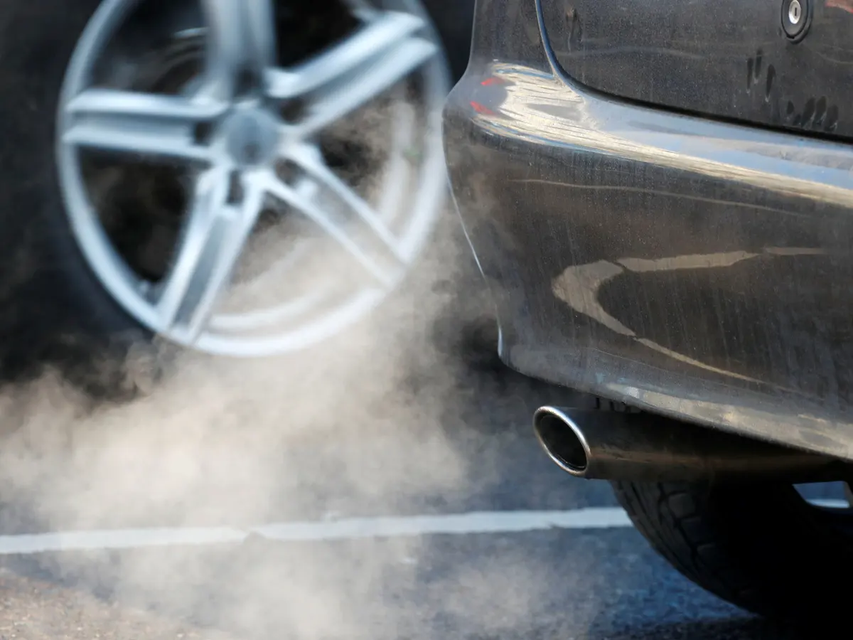
Introduction
Vehicle emissions are the release of pollutants, including greenhouse gases and particulate matter, from vehicles, contributing to air pollution and climate change. The "Prediction of CO2 Vehicle Emissions" project aims to forecast CO2 emissions from Canadian light-duty vehicles using fuel consumption data from 2015 to 2024. By employing data-driven approaches, the project seeks to uncover trends, correlations, and predictive models to guide stakeholders toward sustainable transportation practices and environmental awareness.

Slide 3
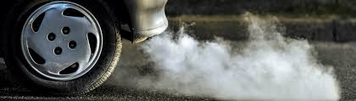
CO2 emissions and why should it be reduced?
CO2 emissions, or carbon dioxide emissions, are gases released into the atmosphere primarily due to human activities such as burning fossil fuels and deforestation. These emissions contribute significantly to the greenhouse effect, leading to global warming and climate change. Reduction of CO2 emissions is imperative to mitigate climate change's adverse effects, including extreme weather patterns, rising sea levels, and ecosystem disruptions. Moreover, it's crucial for improving air quality, preserving biodiversity, and fostering sustainable development. By transitioning to low-carbon technologies and practices, we can address these challenges, protect the environment, and ensure a sustainable future for future generations.

Slide 4
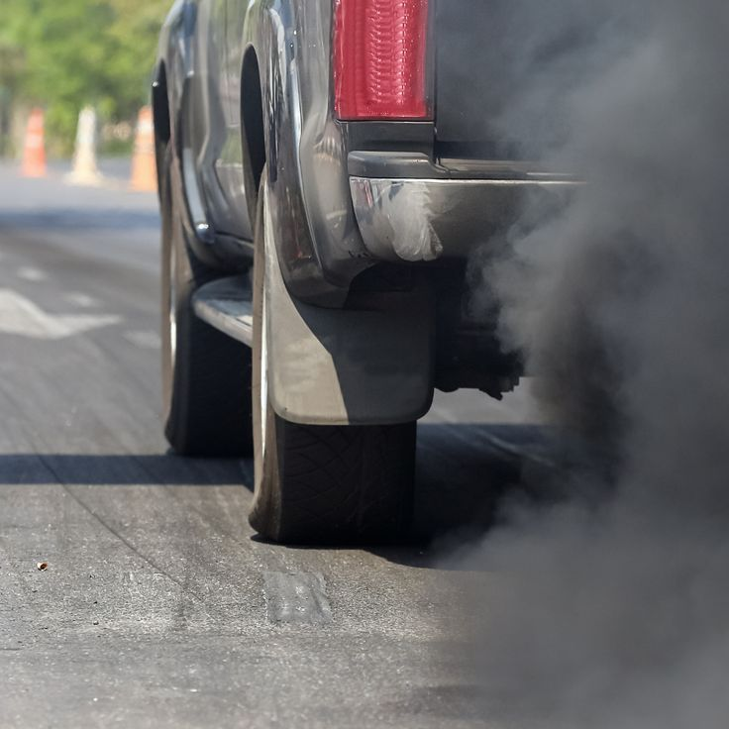
Data source
The dataset, spanning from 2015 to 2024 and sourced from Canada, offers a detailed exploration of over 9,900 cars, exploring fuel efficiency and emissions. It includes parameters like make, model, engine size, fuel type, and fuel consumption ratings for city and highway driving. Additionally, CO2 emissions data is provided, offering insights into the environmental impact of different vehicle models. Analysis of this dataset can reveal trends in fuel efficiency, emission levels, and the effectiveness of environmental regulations over time.
Link: https://open.canada.ca/data/en/dataset/98f1a129-f628-4ce4-b24d-6f16bf24dd64#wb-auto-6

Slide 5
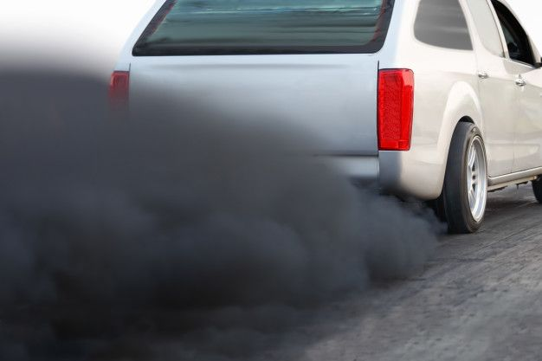
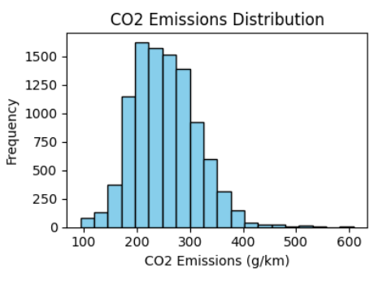
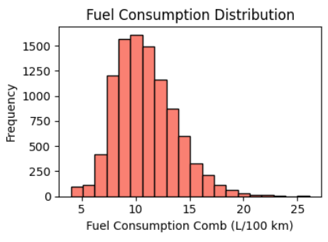
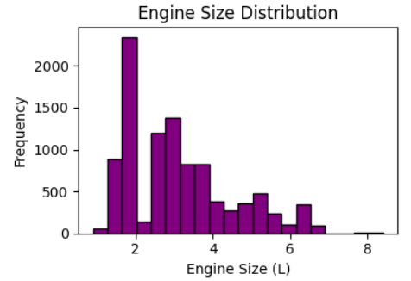
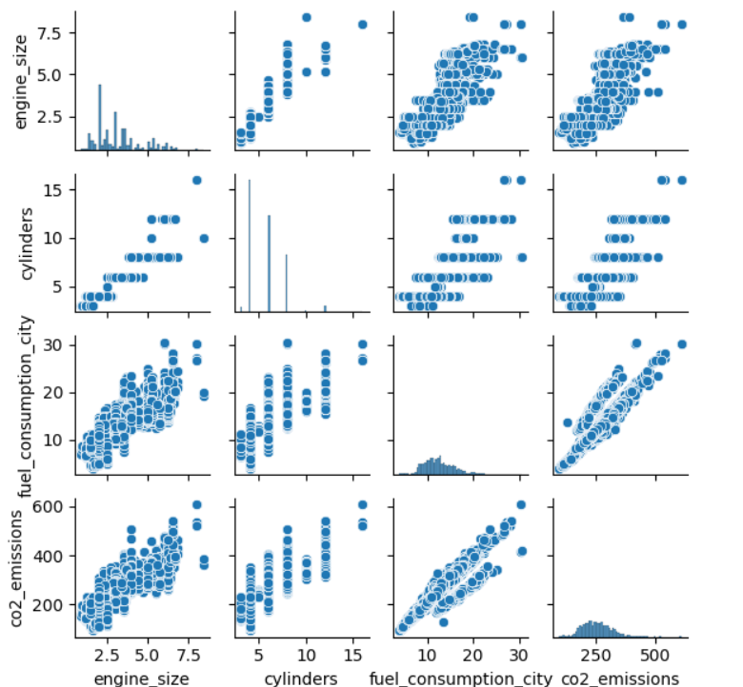
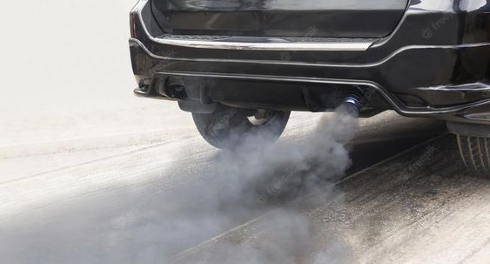
Analysis of Distributions:
Pair Plot Analysis:

Slide 6
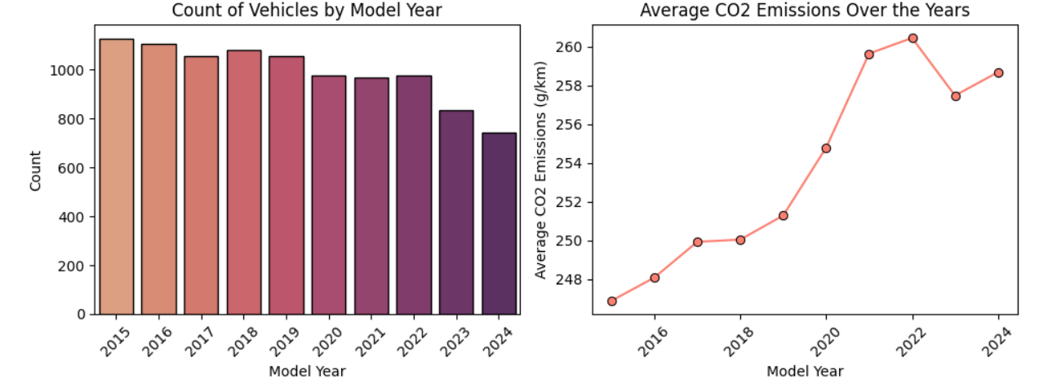
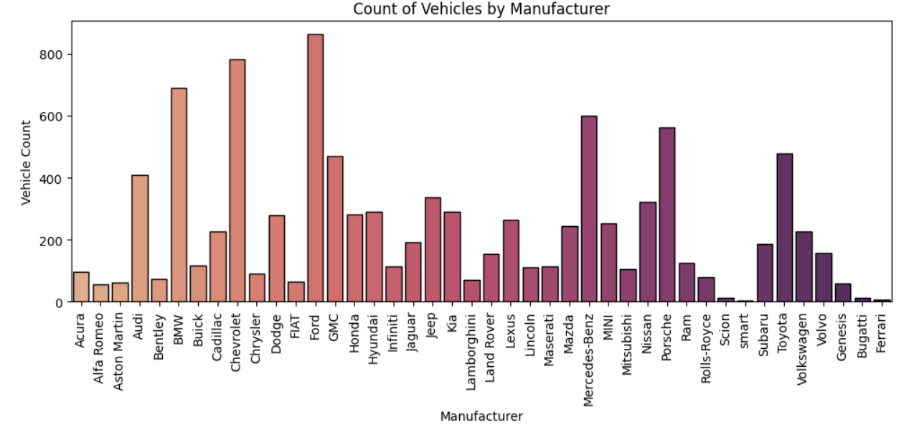
Comparison of Vehicle count and CO2 emissions over the years:
Manufacturer-wise Vehicle Production

Slide 7
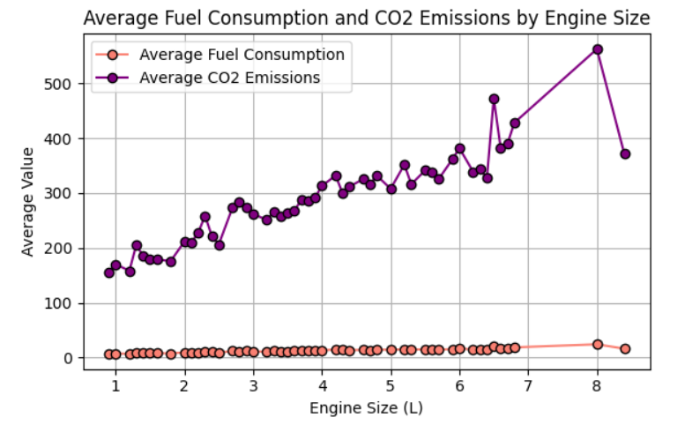
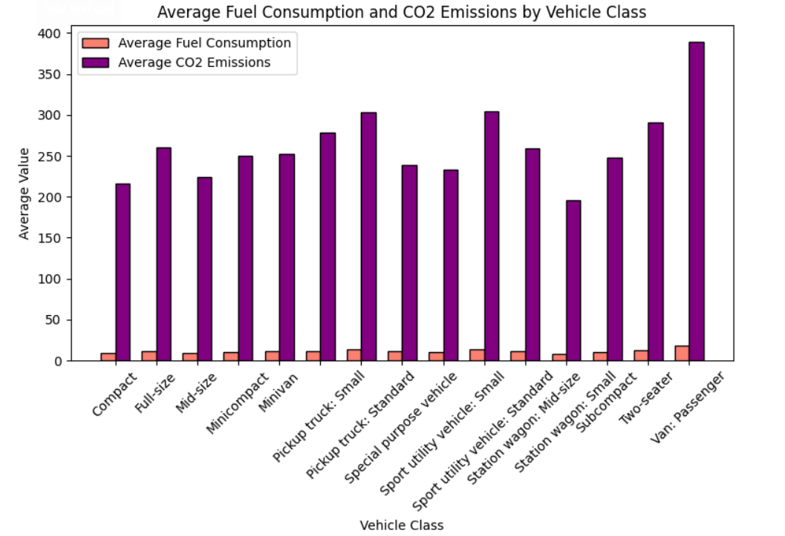
Average Fuel Consumption and CO2 Emissions by Engine Size:
Average Fuel Consumption and CO2 Emissions by Vehicle Class:

Slide 8
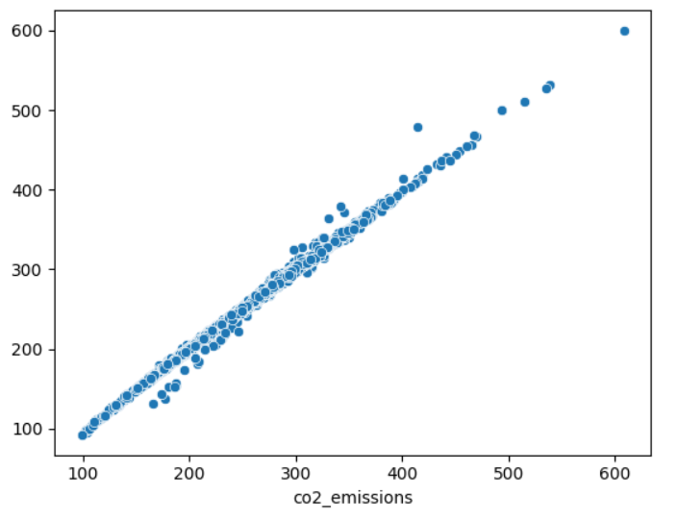
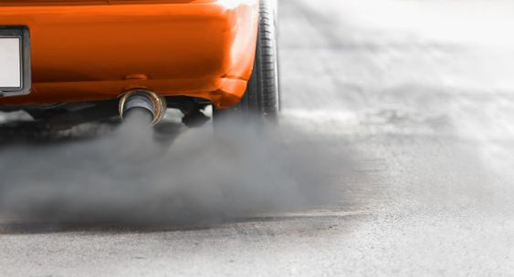
Linear Regression
Feature Selection:
Lasso regression is used for feature selection to identify influential predictors of CO2 emissions.
Selected features include model year, cylinders, fuel consumption rates (city, highway, combined), fuel type D, and fuel type E.
Baseline Model:
Linear regression model is then trained on the selected features to predict CO2 emissions.
Performance evaluation metrics:
Mean Squared Error (MSE): 13.71
Root Mean Squared Error (RMSE): 3.70
R-squared (R^2) Score: 0.996
The model demonstrates high accuracy in predicting CO2 emissions from vehicles based on fuel consumption data.

Slide 9
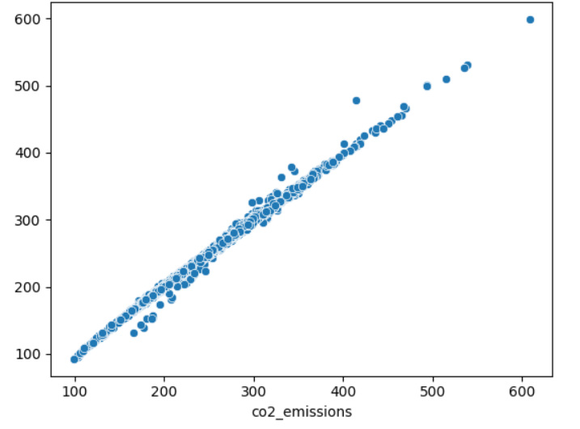
Lasso Regression
Feature Scaling:
Lasso regression is applied with standard scaling to account for feature scaling.
Baseline Model:
Performance metrics after scaling:
Mean Squared Error (MSE): 13.80
Root Mean Squared Error (RMSE): 3.71
R-squared (R^2) Score: 0.996
LassoCV is utilized with cross-validation to find the optimal alpha parameter.
Hyperparameter Tuning:
Best alpha value obtained: 0.01.
Performance metrics after LassoCV with optimal alpha:
Mean Squared Error (MSE): 13.82
Root Mean Squared Error (RMSE): 3.72
R-squared (R^2) Score: 0.996
The model's performance remains consistent after applying standard scaling and performing LassoCV for hyperparameter tuning.

Slide 10
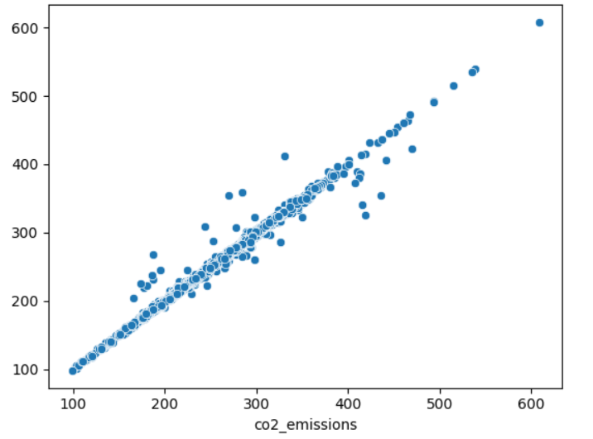
k-nearest neighbour (knn)
Baseline Model:
K-nearest neighbors (KNN) regression is implemented with 5 neighbors.
Performance metrics for KNN:
Mean Squared Error (MSE): 9.62
Root Mean Squared Error (RMSE): 3.10
R-squared (R^2) Score: 0.997
The KNN model demonstrates good performance with relatively low MSE and high R^2 score, indicating a strong fit to the data.
Hyperparameter Tuning:
K-nearest neighbors (KNN) regression is tuned using grid search with cross-validation (CV).
The hyperparameter grid includes number of neighbors, weights, and distance metrics.
Performance metrics for the best model:
Mean Squared Error (MSE): 33.17
Root Mean Squared Error (RMSE): 5.76
R-squared (R^2) Score: 0.991
The tuned KNN model demonstrates good performance with a relatively low RMSE and high R^2 score, indicating a strong fit to the data.

Slide 11
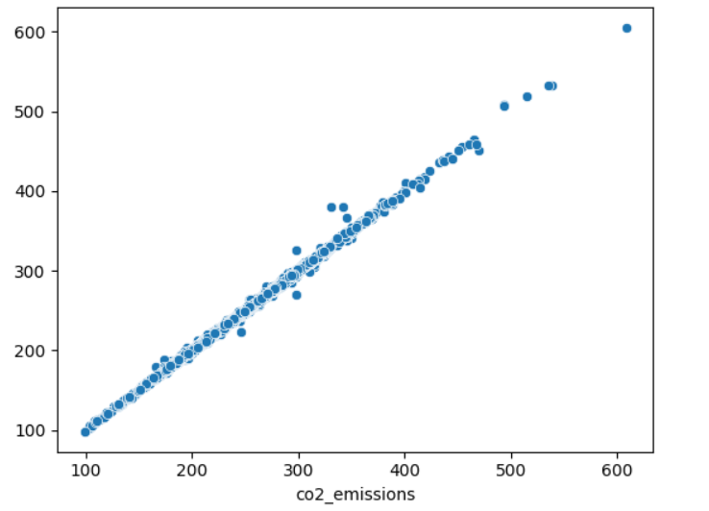
Random Forest
Baseline Model:
Random Forest regression is applied to the dataset without hyperparameter tuning.
The model is trained on scaled training data and evaluated on scaled test data.
Performance metrics for the Random Forest model:
Mean Squared Error (MSE): 4.32
Root Mean Squared Error (RMSE): 2.08
R-squared (R^2) Score: 0.999
The Random Forest model demonstrates superior performance with significantly lower RMSE and higher R^2 score compared to other models, indicating a strong fit to the data.
Hyperparameter Tuning:
Randomized Search Cross Validation (RandomizedSearchCV) is utilized to find the optimal hyperparameters for the Random Forest model.
The hyperparameter space includes parameters such as the number of estimators, maximum depth of trees, and minimum samples required for splitting and leaf nodes.
Performance metrics for the best Random Forest model:
Mean Squared Error (MSE): 5.15
Root Mean Squared Error (RMSE): 2.27
R-squared (R^2) Score: 0.998
The RandomizedSearchCV approach helps optimize the Random Forest model's hyperparameters, resulting in improved performance compared to the baseline Random Forest model.

Slide 12
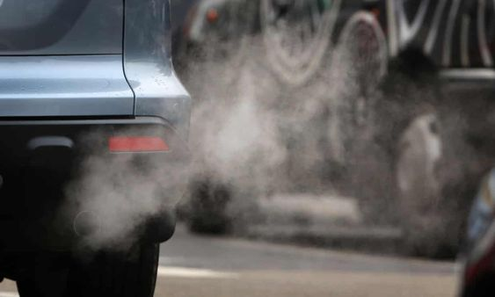
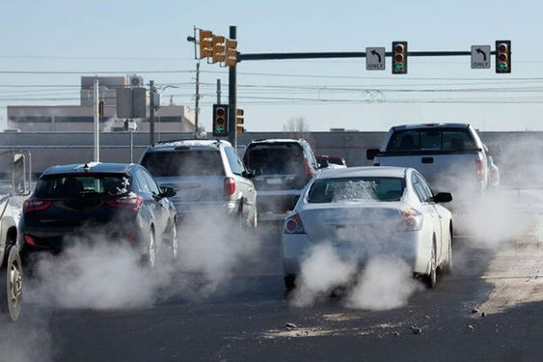
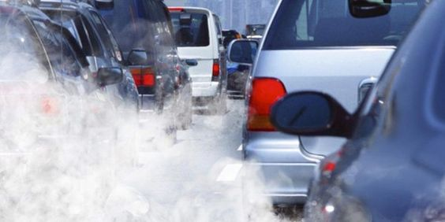
Comparison of Model Performance
Linear Regression and Lasso Regression
These models provide a baseline understanding of the linear relationships between features like engine size, cylinders, and fuel consumption with CO2 emissions. They offer moderate predictive accuracy but may overlook non-linear relationships present in the data.
K-Nearest Neighbors (KNN)
Utilizes the similarity of vehicles in the dataset to predict CO2 emissions, making it suitable for capturing complex patterns. However, its performance may vary based on the similarity of vehicles and the choice of distance metric.
Random Forest
Excels in capturing non-linear relationships and interactions between features, making it well-suited for the complex nature of vehicle emissions prediction. It provides the highest predictive accuracy by leveraging ensemble learning and capturing diverse patterns present in the data.

Slide 13
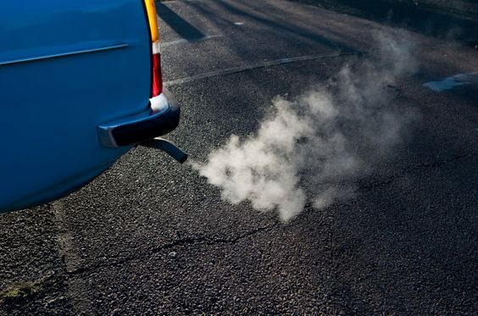
Conclusion
Due to its superior performance in accurately predicting CO2 emissions, Random Forest is recommended as the primary model for this dataset. Its ability to handle non-linear relationships and interactions between features aligns well with the complexities of vehicle emissions data.

Slide 14
References
https://open.canada.ca/data/en/dataset/98f1a129-f628-4ce4-b24d-6f16bf24dd64#wb-auto-6
https://ourworldindata.org/co2-emissions
https://www.europarl.europa.eu/topics/en/article/20190313STO31218/co2-emissions-from-cars-facts-and-figures-infographics

